Slide 1
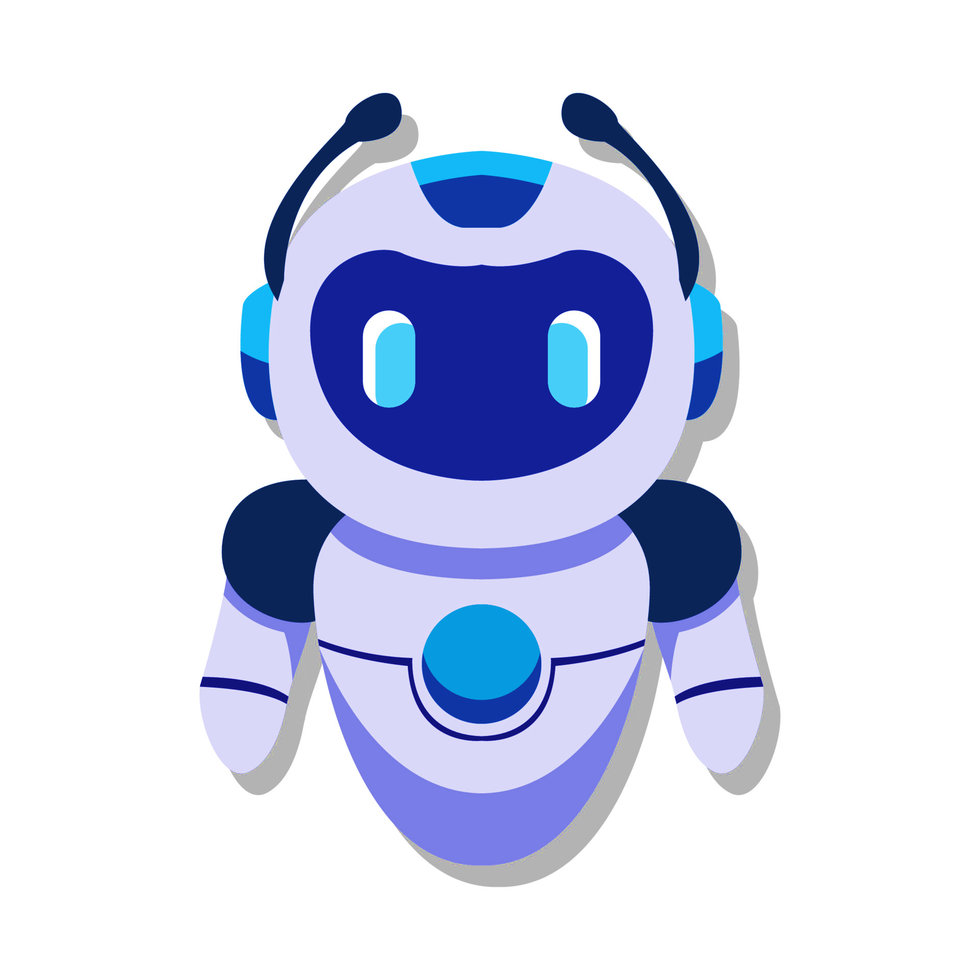
Chatbot
Presentation

Slide 2
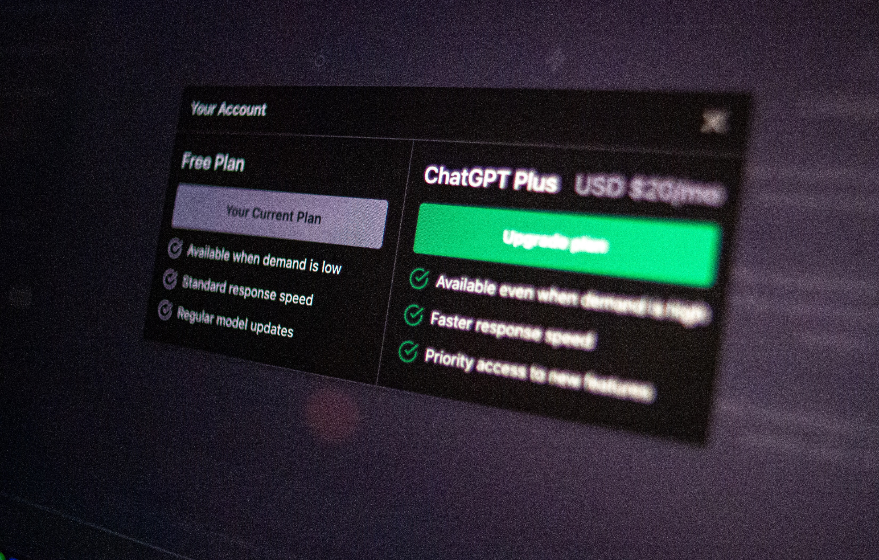
What Is Chatbot?
A chatbot is a computer program designed to simulate conversation with human users, especially over the Internet. Chatbots are often used in customer service, virtual assistants, and various other applications where interaction with users is necessary.
ARTIFICIAL INTELLIGENCE (AI)

Slide 3
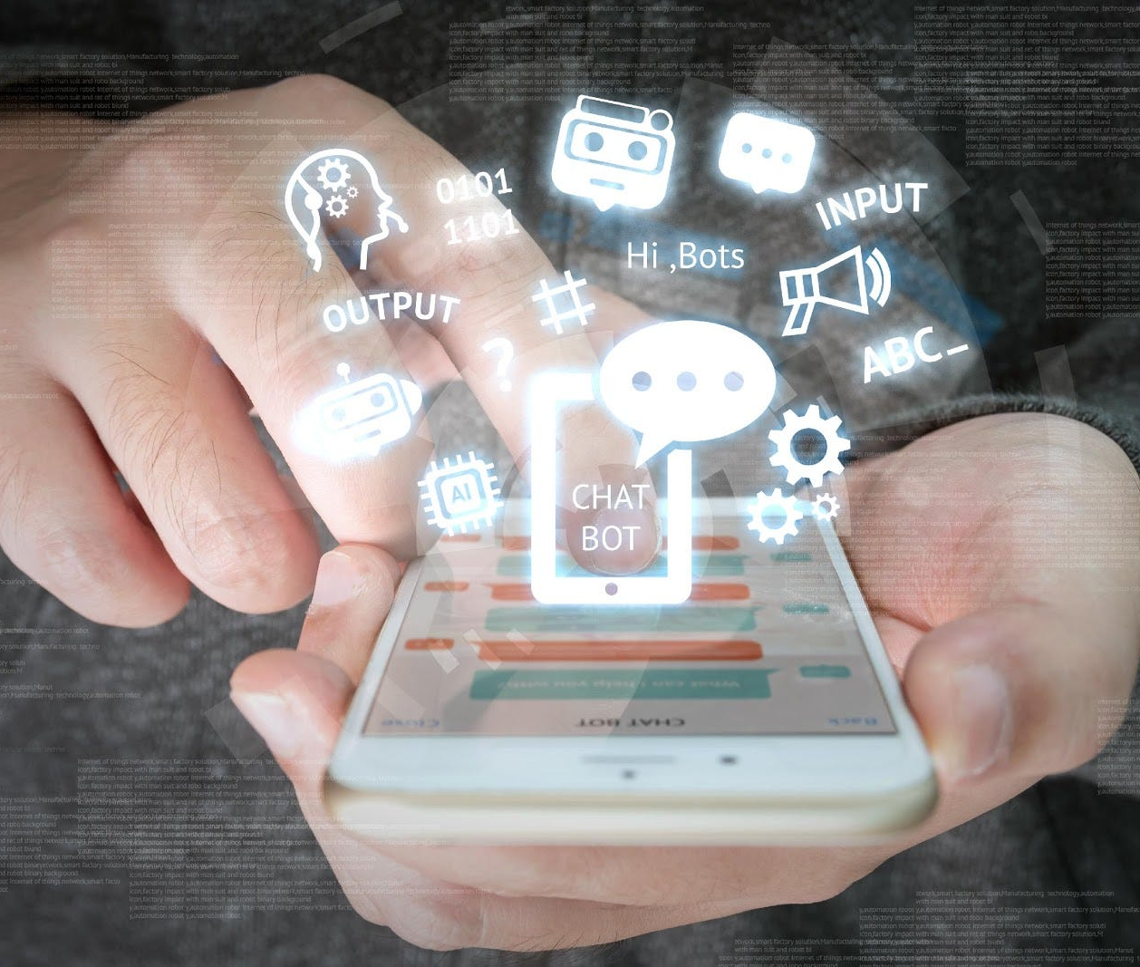


How Do Chatbots Work?
Chatbots work by using various technologies to understand and respond to user input in a conversational manner. The basic process involves natural language processing (NLP), intent recognition, and generating appropriate responses
PAGE
3

Slide 4
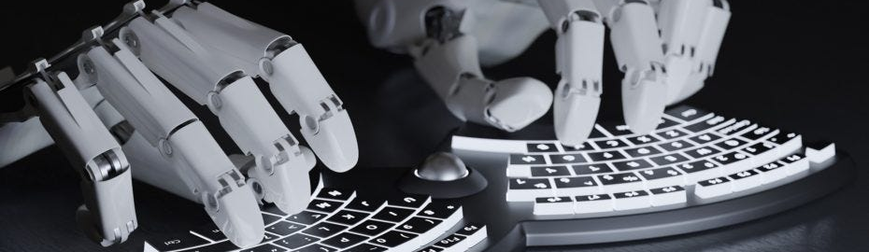
How Chatbots Typically Work
01
02
03
User Input:
Natural Language Processing:
Intent Recognition:
Users interact with the chatbot by typing or speaking natural language input, asking questions, or making requests.
NLP is a key component of chatbot functionality. It involves the ability of the chatbot to understand and interpret human language.
Once the chatbot has processed the user input, it identifies the user's intent—what the user is trying to accomplish or inquire about.

Slide 5
How Chatbots Typically Work
04
05
06
07
Dialog Management
Query Processing
Delivery of Response
Integration with External Systems
Smart chatbots maintain context, recalling past interactions for improved, coherent responses in communication.
Chatbot interprets user intent, extracts entities, and fetches data from databases, APIs, or knowledge bases.
Chatbot responds via platform interface—messaging app, website, or other channels, facilitating user interaction seamlessly.
Chatbot integrates with external systems for tasks, real-time data retrieval using databases, or APIs.

Slide 6



Why Were Chatbots Created?
Chatbots were created to automate and streamline communication processes, providing a more efficient way for businesses and organizations to interact with users. The development and deployment of chatbots have been driven by several key motivations:

Slide 7
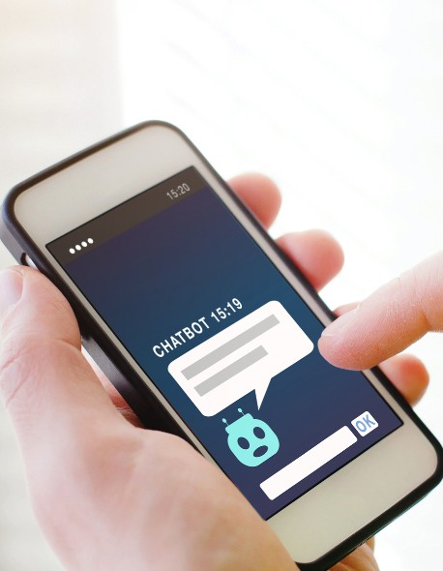
Customer Service and Support
Automation of Repetitive Tasks
Chatbots aid customer service, offering instant responses and 24/7 availability for common queries and assistance.
Chatbots automate tasks like scheduling, tracking orders, and retrieving information, streamlining routine operations.
Several Key
Cost Savings
Scalability
Chatbot automation cuts costs by handling routine tasks, streamlining operations, and reducing support teams.
Chatbots scale efficiently, managing numerous conversations without proportional resource increase, ideal for engagement spikes.

Slide 8
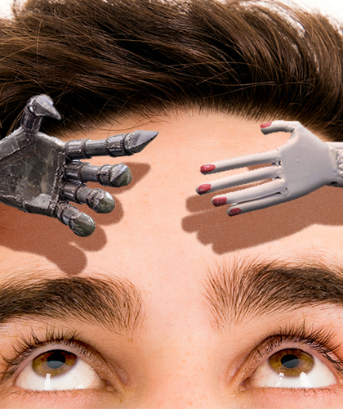


Several Key
Marketing and Engagement:
Chatbots are used in marketing to engage with users, answer product-related questions, and provide information
Data Collection and Analysis:
Chatbots can collect valuable data on user preferences, behavior, and frequently asked questions.
Technological Advancements
Advances in natural language processing (NLP), machine learning, and artificial intelligence have made it possible to create more sophisticated.

Slide 9




Are Chatbots Bad?
Design and Functionality
User Experience
Privacy Concerns
Accessibility
Effective chatbots enhance user experience, meeting needs and delivering accurate information positively.
Effective chatbots, offering swift and relevant information, enhance user experience and garner positive reception
If chatbots handle sensitive information without proper security measures, it can lead to privacy concerns.
Chatbots can enhance accessibility by providing information and services to users with diverse needs.

Slide 10
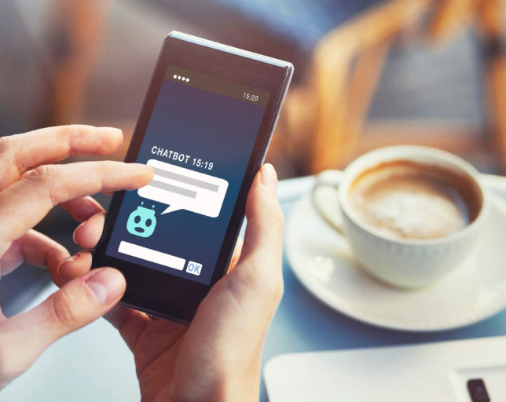
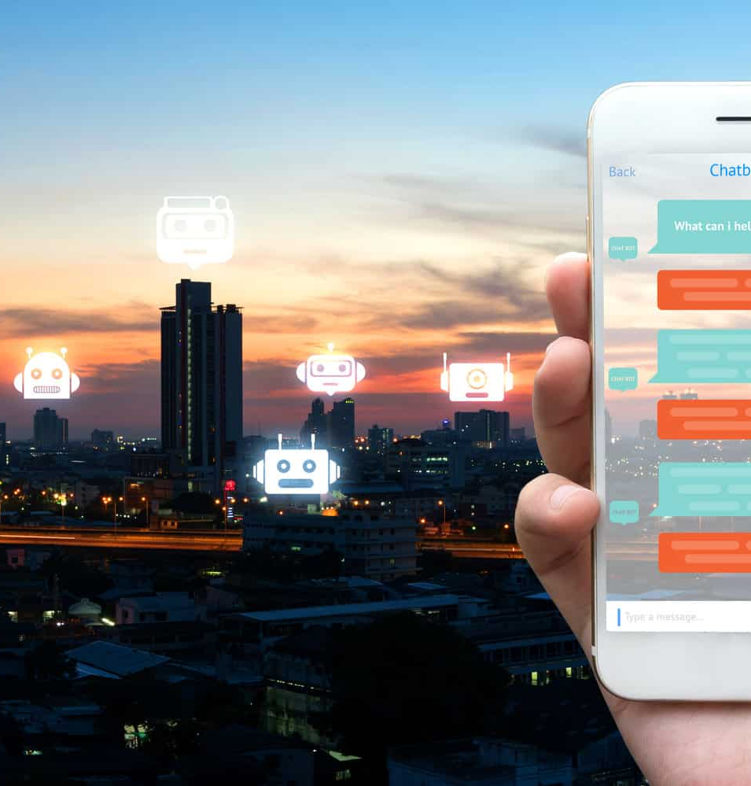
Chatbot Design And Development
Designing and developing a chatbot involves several steps, including planning, implementation, and testing. Here is a comprehensive guide for the design and development of a chatbot:

Slide 11





Here Is A Comprehensive Guide For The Design And Development Of A Chatbot
Define Objectives and Scope
Understand the Audience
Select Technology and Tools
Design Conversational Flow
Intent Recognition
Clearly define the purpose of the chatbot and its intended goals.
Identify the target audience for the chatbot.
Choose the appropriate technology stack for your chatbot
Plan the conversation flow considering different user scenarios.
Define various user intents and train the chatbot to recognize them.
Identify the tasks it will perform and the problems it will solve.
Understand user preferences, language, and expectations.
Consider using existing chatbot development platforms or frameworks.
Design user prompts and system responses for each interaction.
Create corresponding actions or responses for each intent.

Slide 12
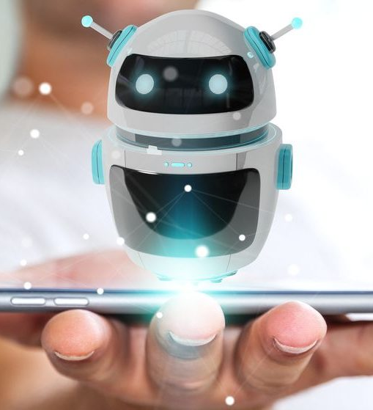
Why Do Users Use Chatbots?
Quick Assistance:
Chatbots are designed to provide quick responses to user queries, helping users find information or solutions to their problems without delay.
Efficiency:
Chatbots streamline processes by automating routine tasks and interactions, allowing users to complete tasks more efficiently.
Availability:
Chatbots are always available, providing users with support or information even during non-working hours or peak times when human agents may be unavailable.
Cost Savings:
Businesses use chatbots to reduce operational costs associated with customer support and repetitive tasks, as they can handle a large volume of inquiries simultaneously.
Personalization:
Advanced chatbots can analyze user preferences and behavior to provide personalized recommendations or tailored experiences.

Slide 13



Why Do Users Use Chatbots?
Learning and Improvement
Reducing Human Error
Language Support
Chatbots evolve, learning from interactions, enhancing performance, and better addressing user needs over time.
Chatbots can minimize errors that may occur due to human factors, providing consistent and accurate information
Chatbots can support multiple languages, making them accessible to users around the world.

Slide 14




Chatbot Features
Intent Recognition
Context Awareness
Personalization
Multichannel Support
Chatbots can identify the intent behind a user's message, determining the user's goal or query to provide a relevant response.
Advanced chatbots grasp context for coherent conversations, comprehending references and handling follow-up questions seamlessly.
Chatbots may offer personalized responses based on user preferences, history, or profile information.
Chatbots offer consistency across websites, messaging apps, and social media for seamless communication.

Slide 15



Chatbot Features
Task Automation
Fallback Mechanism
Emotion Recognition
Chatbots can be programmed to perform specific tasks, such as making reservations, providing information, or guiding users through processes.
In cases where the chatbot doesn't understand a user's input, a fallback mechanism allows it to provide a default response or ask clarifying questions.
Advanced chatbots may incorporate emotion recognition to understand and respond appropriately to the emotional tone of the user.

Slide 16



Chatbot Problem
Misunderstanding User Input
The chatbot is not correctly understanding or interpreting user queries.`
Limited Responses
The chatbot provides limited or repetitive responses, leading to a poor user experience.

Slide 17




Chatbot Problem
Integration Issues
Security Concerns
Lack of Context Awareness
Limited Platform Support
The chatbot fails to integrate smoothly with external systems or APIs.
Users are concerned about the security and privacy of their data.
The chatbot struggles to maintain context across multiple turns of conversation.
The chatbot is not available on the desired platforms or channels.

Slide 18
Chatbot Solution
Testing
Deploy
Define Objectives
Comprehensively test your chatbot for expected performance, user inputs, edge cases, and errors.
Deploy chatbot on website, app, Facebook, Slack, WhatsApp for broader accessibility and engagement.
Define chatbot tasks: info delivery, FAQs, transaction assistance. Clarify specific interactions for effective performance.
Here are the key steps and considerations to guide you through the process:
Choose a Platform
Design Flow
Compliance and Security
Decide whether you want to build your chatbot from scratch using programming languages and frameworks or use a chatbot development platform.
Design the conversational flow of your chatbot. Plan how the chatbot will greet users, handle user inputs, and provide responses.
Ensure chatbot complies with privacy laws, secure data, prevent unauthorized access for user protection

Slide 19








Pattern Matching
Key Components:
01
02
03
04
Pattern
Target Data
Matching Algorithm
Keyword Recognition
The template or specific arrangement of elements that the matching algorithm seeks to identify.
The dataset or input where the pattern matching algorithm looks for occurrences of the specified pattern.
The set of rules and logic that determines whether a given portion of the target data matches the defined pattern.
Keyword identification in user input aids chatbot understanding, ensuring context-appropriate responses.

Slide 20
Icons

Slide 21
Icons

Slide 22
How To Edit Shapes
You can add and edit some shapes to your presentation to present your data in a visual way.
Choose your favourite infographic and insert it in your presentation using Ctrl C + Ctrl V or Cmd C + Cmd V in Mac.
Select one of the parts and ungroup it by right-clicking and choosing “Ungroup”.
Change the color by clicking on the paint bucket.
Then resize the element by clicking and dragging one of the square-shaped points of its bounding box (the cursor should look like a double-headed arrow). Remember to hold Shift while dragging to keep the proportions.
Group the elements again by selecting them, right-clicking and choosing “Group”.
Repeat the steps above with the other parts and when you’re done editing, copy the end result and paste it into your presentation.
Remember to choose the “Keep source formatting” option so that it keeps the design. For more info, please visit Slideegg (Tips & Tricks).

Slide 23
Terms Of Use (Free Users)
If you are a free subscriber, you should credit SlideEgg by keeping the “Thank You” slide.
Kindly refer to the following slide for the Terms of Use for premium users.
You can:
Customize or edit this template
Use this template for both business and personal endeavors.
You can not:
Sell, rent, or second-license SlideEgg content or its altered version. Promulgate, unless explicitly permitted, SlideEgg content, by SlideEgg.
Incorporate SlideEgg content in any database or file online or offline.
Obtain SlideEgg content’s copyright.
Kindly refer to our Tutorial page or FAQ for advanced slide modification guidelines.

Slide 24
Terms Of Use (Premium Users)
Being a premium subscriber, you have the privilege of using this PPT template
without giving attribution to SlideEgg or keeping the “Thank You” slide.
You can:
Customize or edit this template.
Use this template for both business and personal endeavors.
Circulate or share the editable format of this template with anyone you want.
You can not:
Sell, rent or second-license SlideEgg content or the altered version of it. Promulgate or include the templates in any other services database
that performs as distribution or resale platform, unless explicitly permitted, by SlideEgg.
Incorporate the elements used in SlideEgg templates separately.
Obtain SlideEgg copyright for the elements used in this template as a logo or trademark.
Kindly refer to our Tutorial page or FAQ for advanced slide modification guidelines.

Slide 25







Thank You!
We respect your valuable time with SlideEgg!
If you have any questions, please reach us
Do you have a design request, please visit our Deckez site.
CREDIT: SlideEgg created this PowerPoint template.
Let this slide be kept for attribution.
www.slideegg.com
PAGE
25

